Slide 1
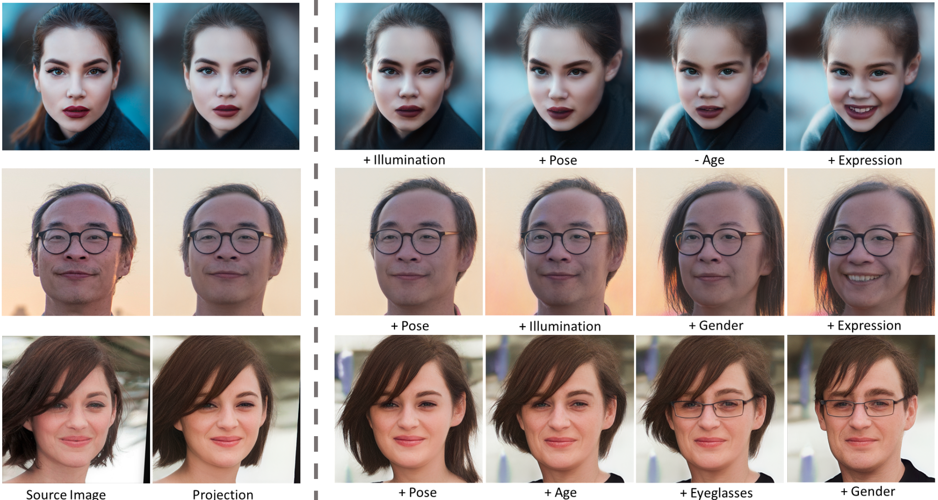

Slide 2
CS172 Discussion Class Introduction to Generative Model
Zibo Zhao
2021.11.2.

Slide 3
Brief Review
Machine learning
Image Classification
Neural Network
Deep Learning Tool
Segmentation
Detection
Generative Model
PixelRnn
Variational Auto-Encoder (VAE)
Generative Adversarial Network (GAN)
http://cs231n.stanford.edu/2019/

Slide 4
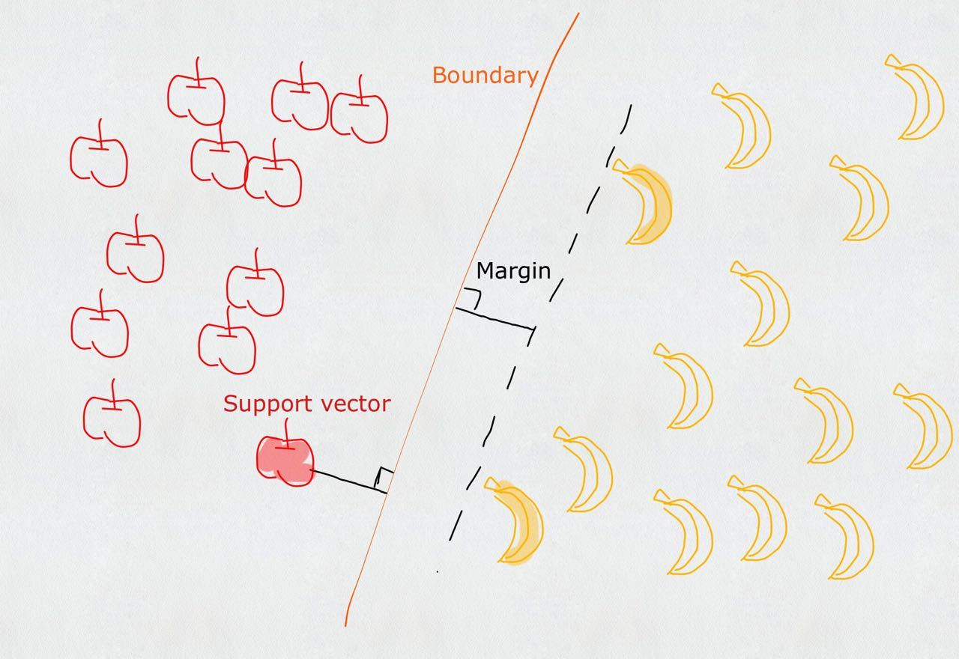
Machine Learning
SVM

Slide 5
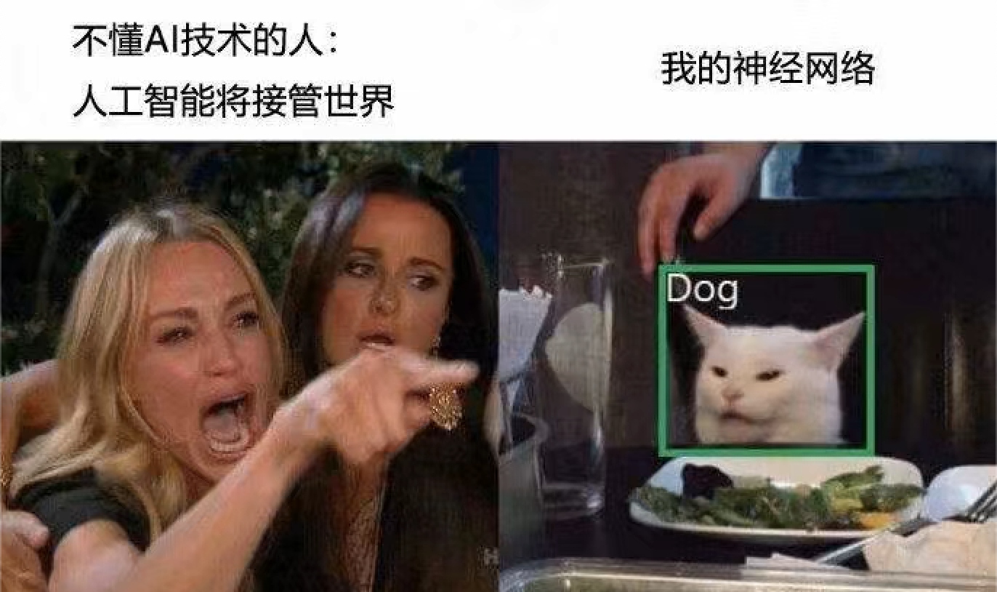
Image Classification

Slide 6
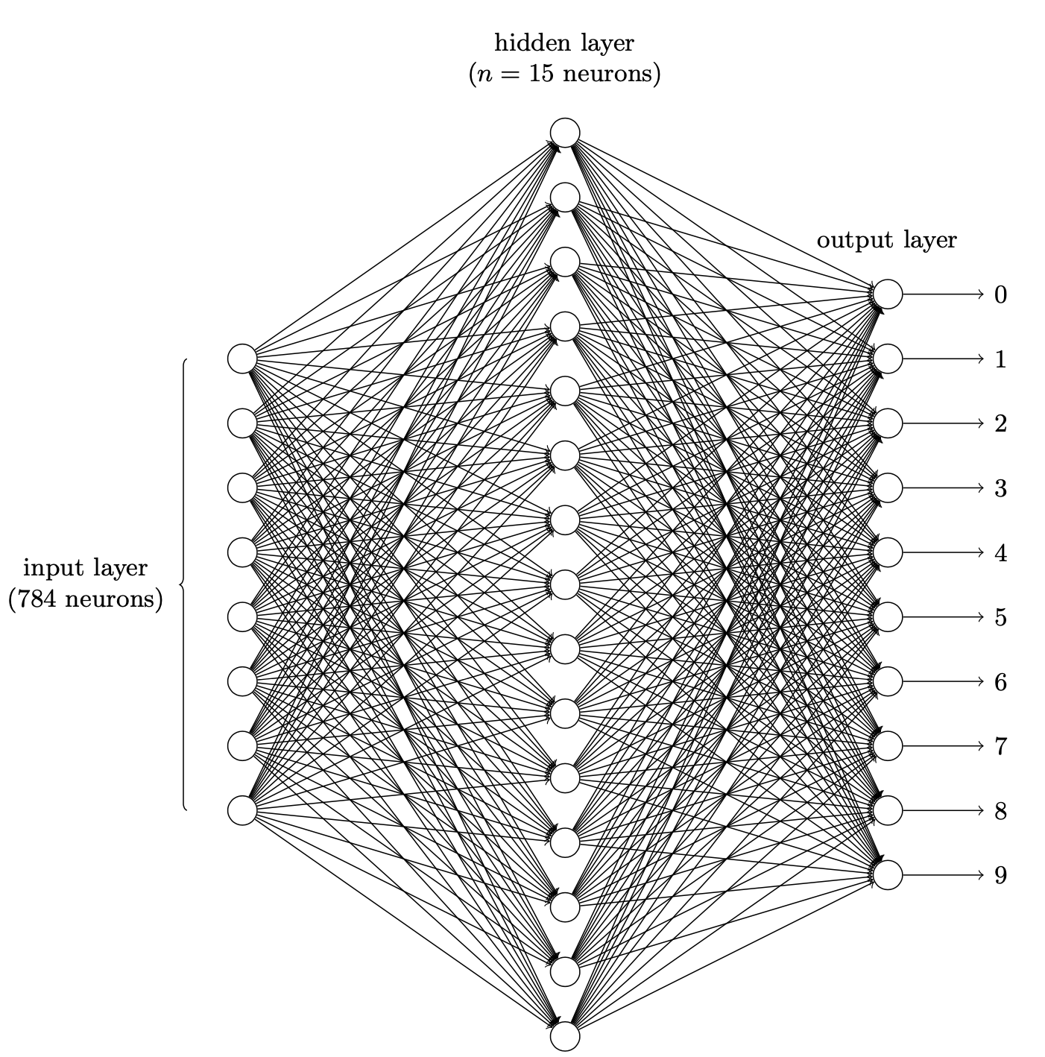
Neural Network

Slide 7

Deep Learning Tool
https://pytorch.org

Slide 8
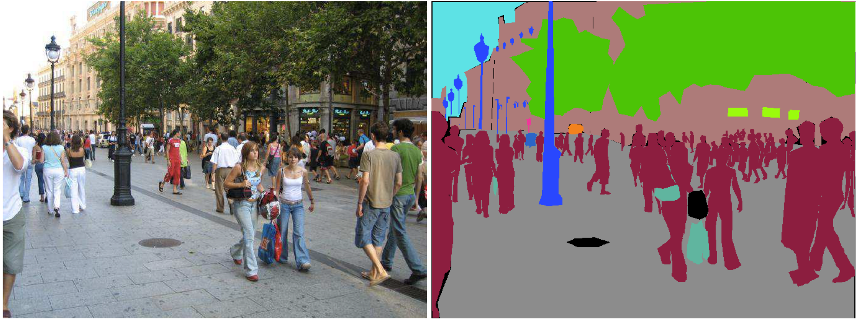
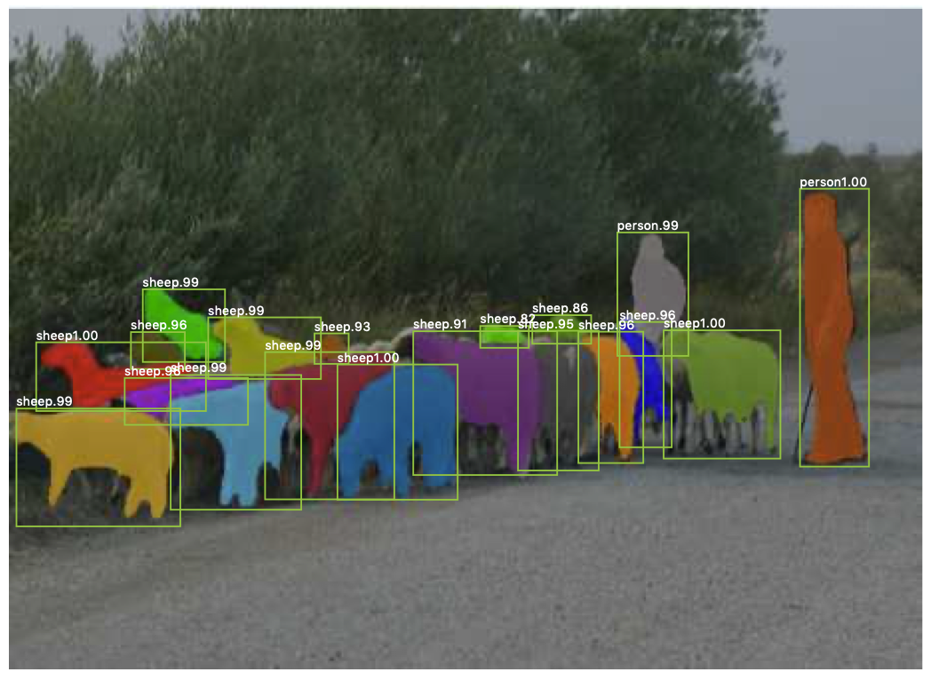
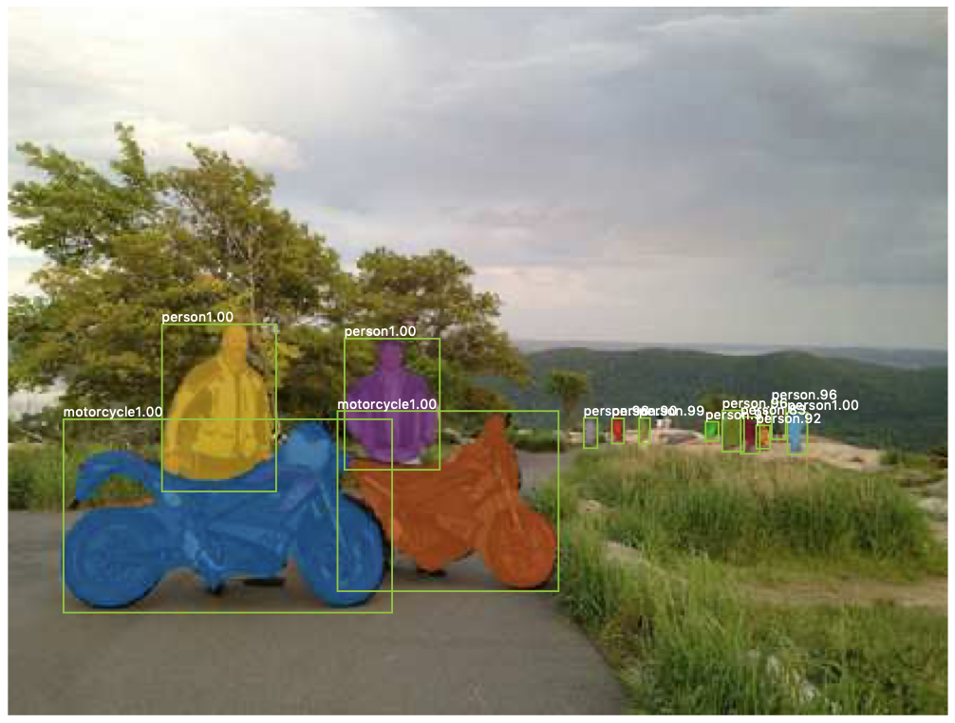
Segmentation
Semantic
Instance
https://arxiv.org/abs/1612.01105
https://openaccess.thecvf.com/content_ICCV_2017/papers/He_Mask_R-CNN_ICCV_2017_paper.pdf

Slide 9
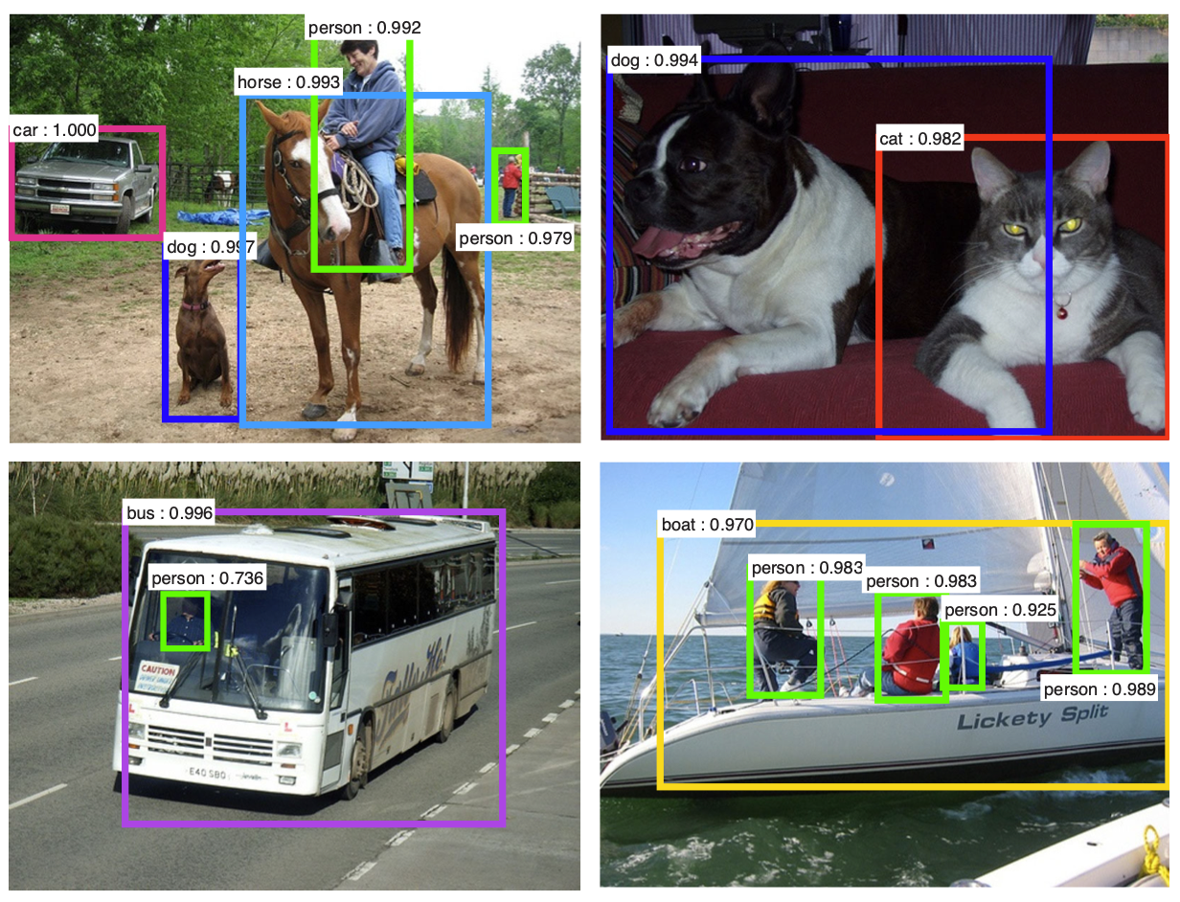
Detection
https://proceedings.neurips.cc/paper/2015/file/14bfa6bb14875e45bba028a21ed38046-Paper.pdf

Slide 10
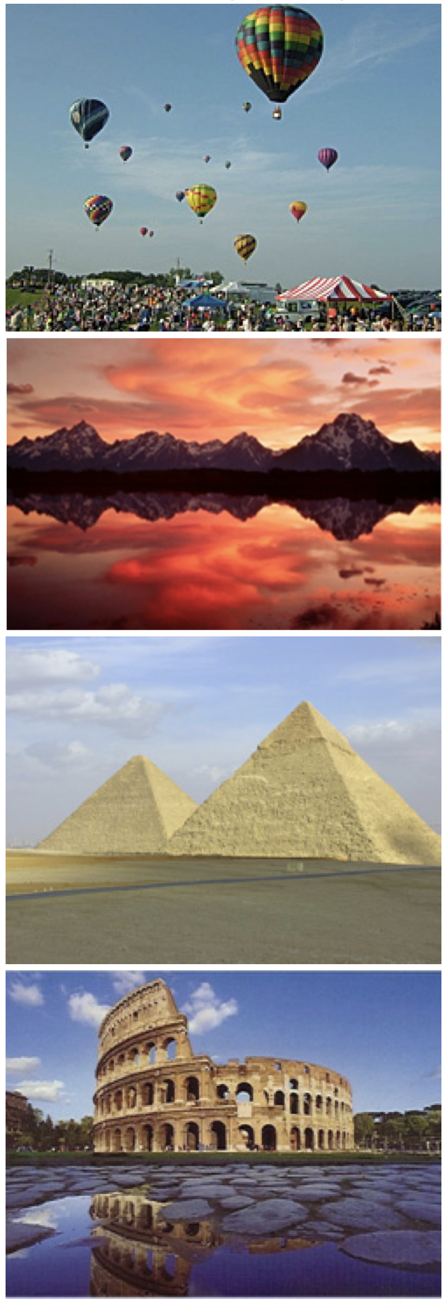
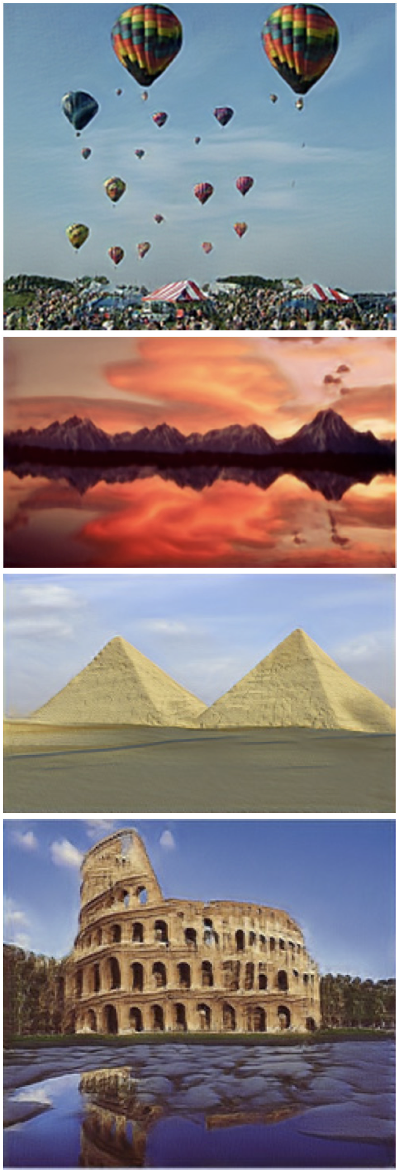
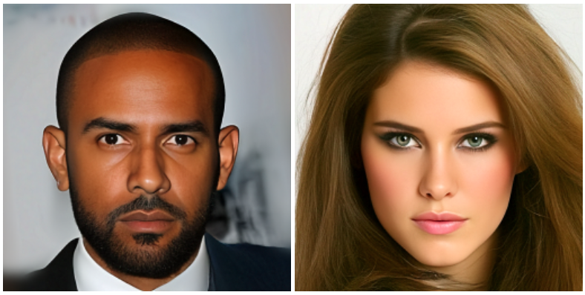
Generative Model
Key
Z
https://arxiv.org/abs/1410.8516
https://arxiv.org/abs/1905.01164

Slide 11
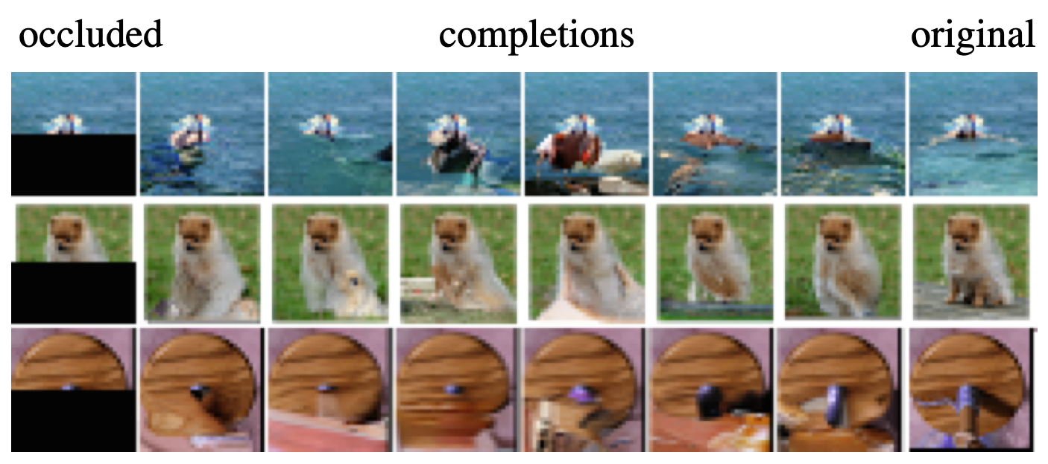
PixelRnn
https://arxiv.org/abs/1601.06759

Slide 12
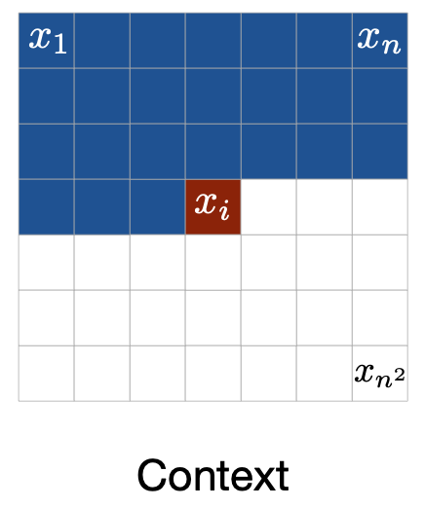
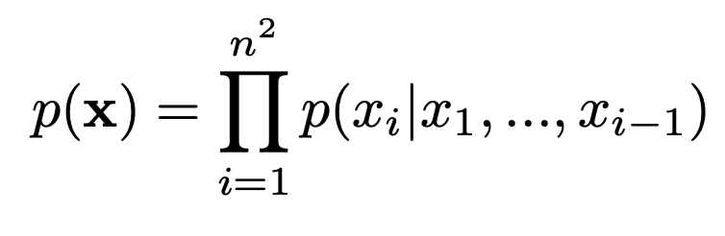
PixelRnn

Slide 13
Variational Auto-Encoder (VAE)
Key
Z
https://arxiv.org/pdf/1312.6114.pdf

Slide 14
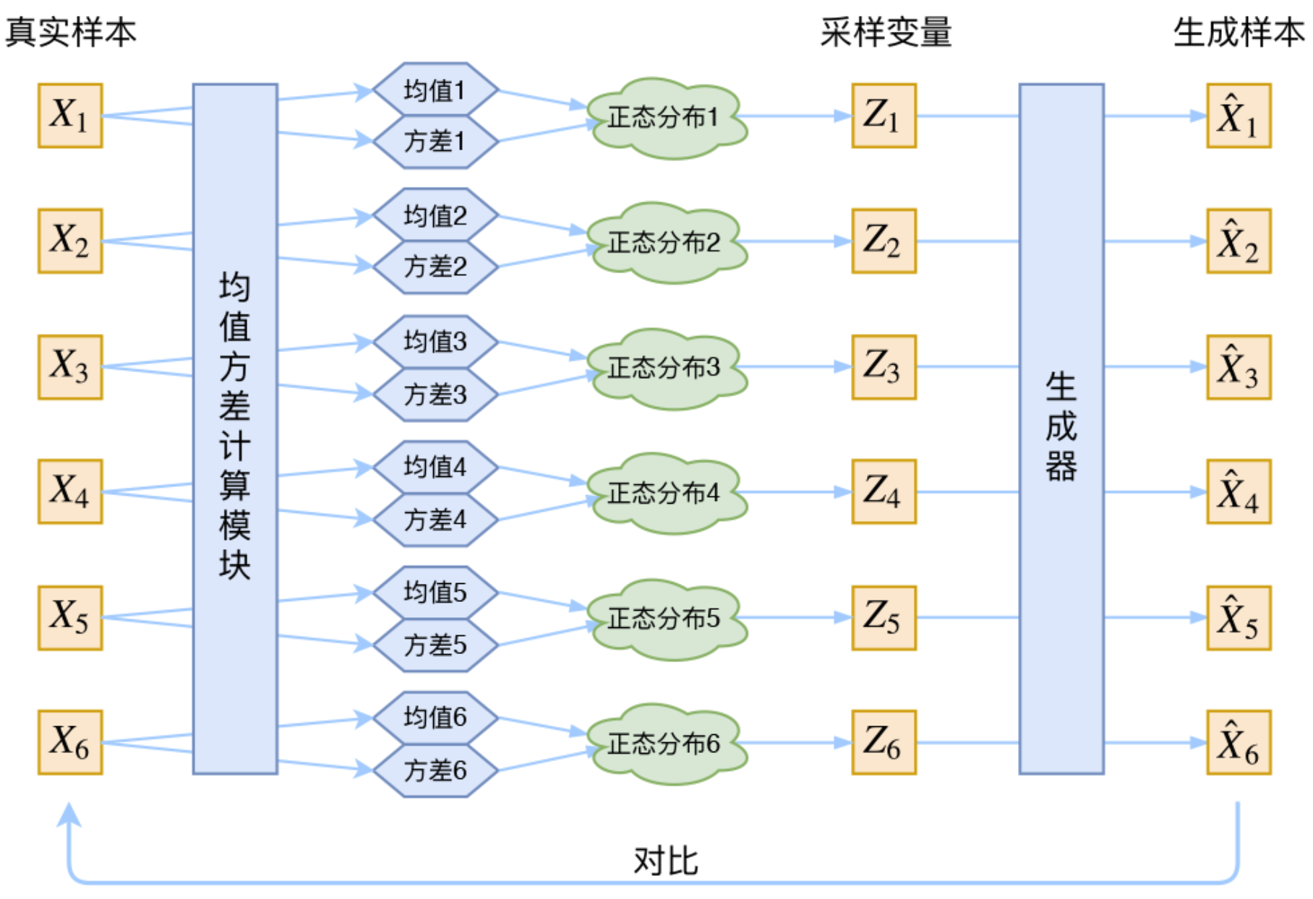
Variational Auto-Encoder (VAE)
https://www.kexue.fm/archives/5253

Slide 15
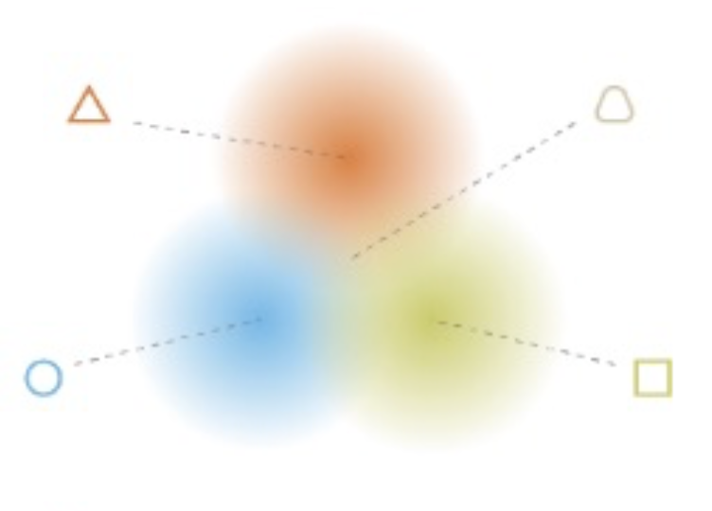
Variational Auto-Encoder (VAE)
Noise
Z
https://www.cnblogs.com/fxjwind/p/9099931.html

Slide 16
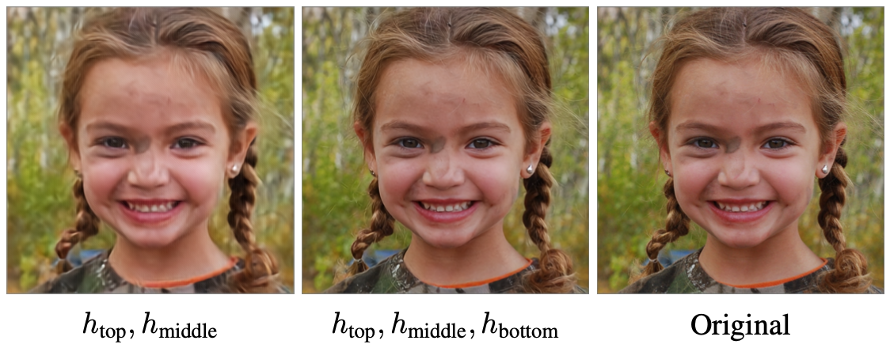
VQVAE 2
https://arxiv.org/abs/1906.00446

Slide 17
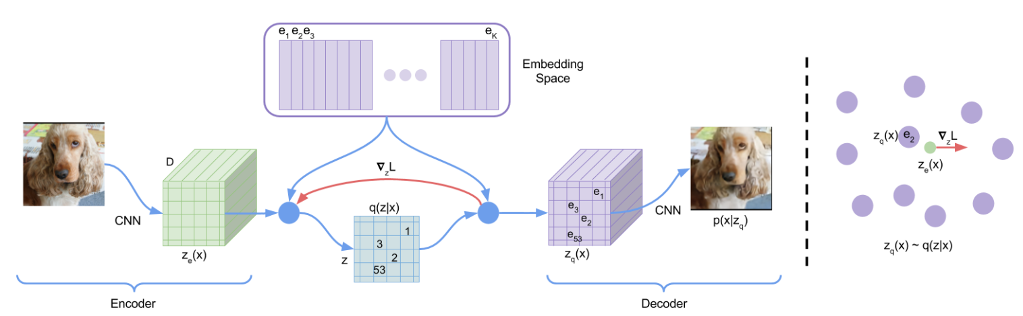
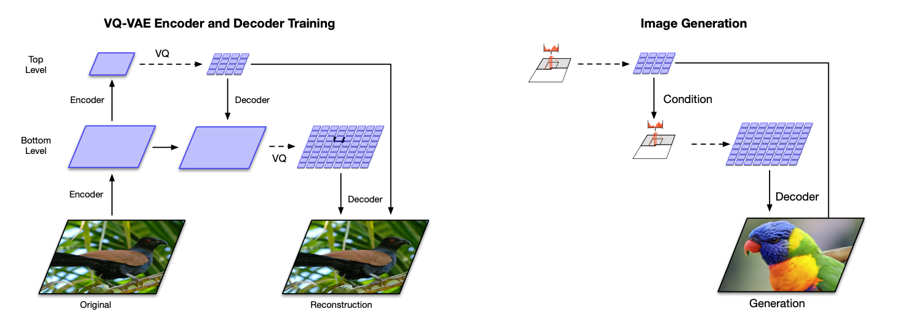
VQVAE 2
https://arxiv.org/abs/1711.00937
https://arxiv.org/abs/1906.00446

Slide 18
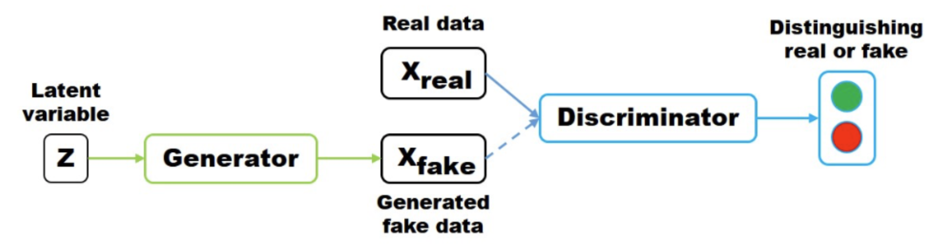
Generative Adversarial Net (GAN)
https://proceedings.neurips.cc/paper/2014/hash/5ca3e9b122f61f8f06494c97b1afccf3-Abstract.html
https://www.jianshu.com/p/331a078036ee

Slide 19
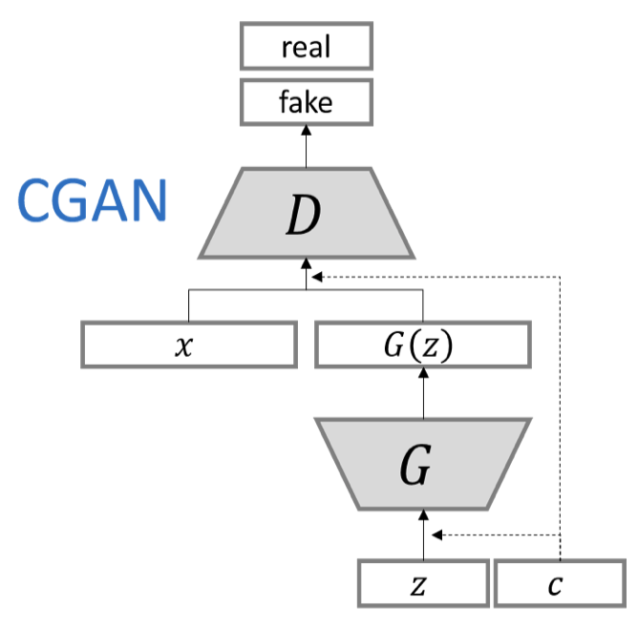
Conditional GAN
https://github.com/hwalsuklee/tensorflow-generative-model-collections
https://openaccess.thecvf.com/content_cvpr_2018/papers/Wang_High-Resolution_Image_Synthesis_CVPR_2018_paper.pdf

Slide 20
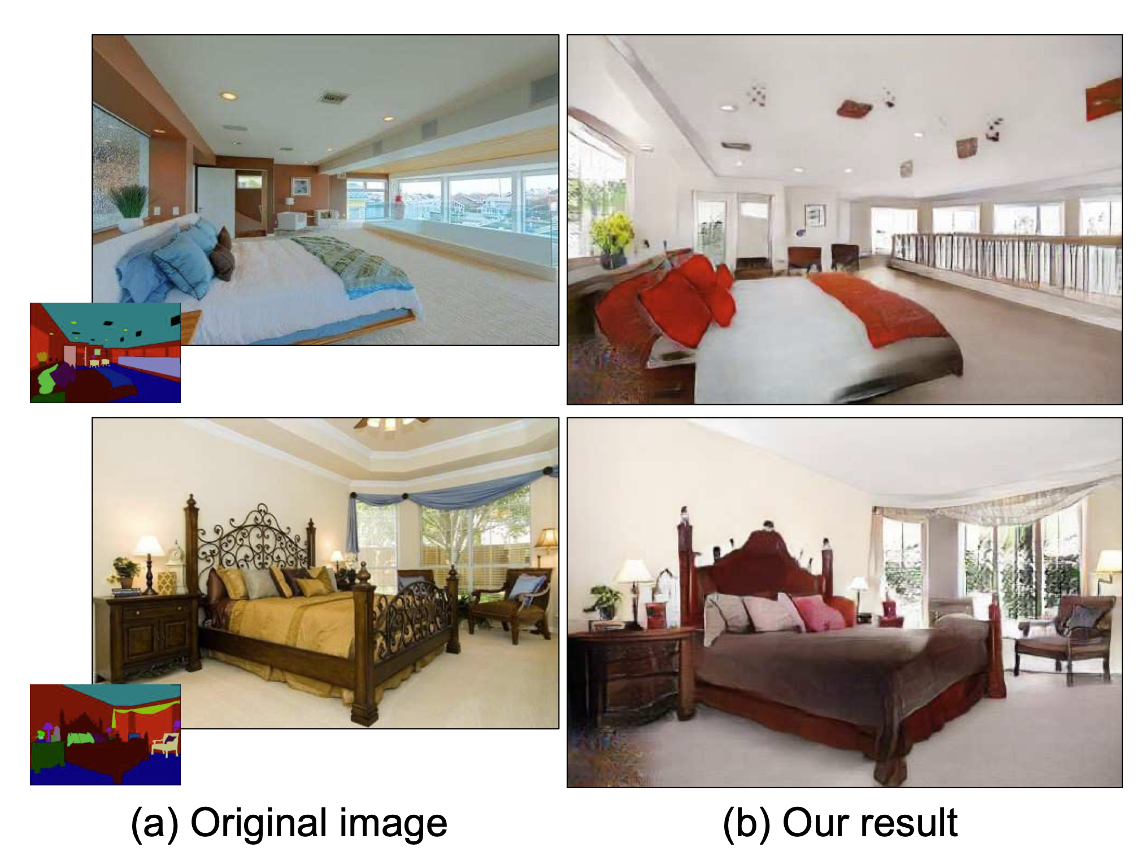
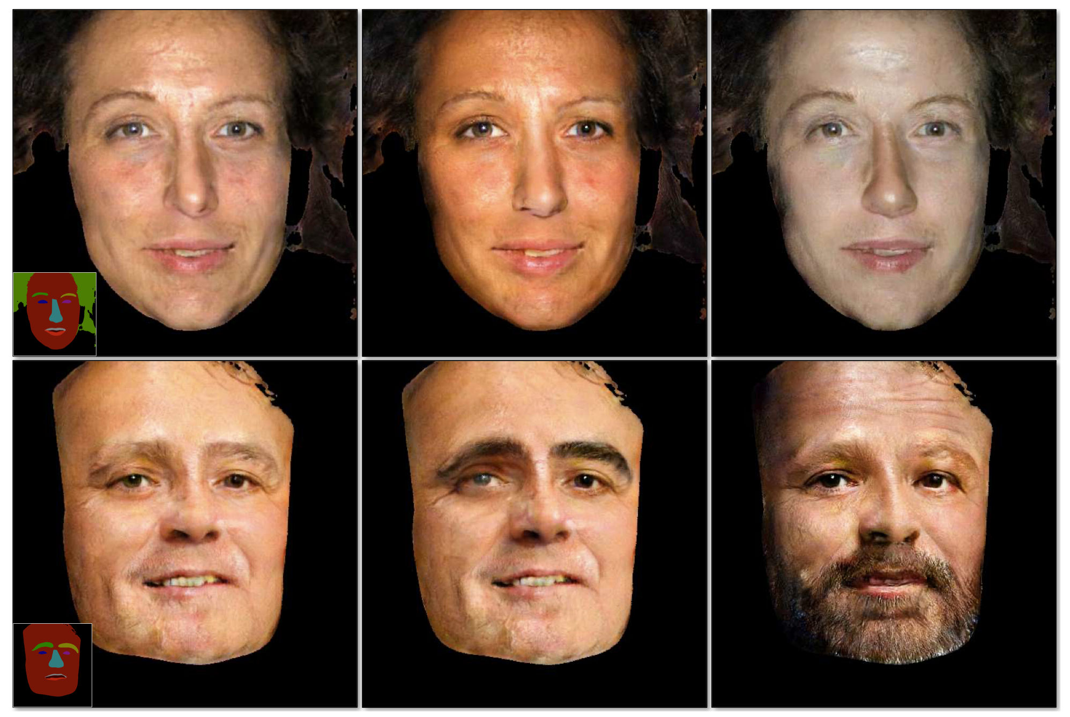
Conditional GAN
https://github.com/hwalsuklee/tensorflow-generative-model-collections
https://openaccess.thecvf.com/content_cvpr_2018/papers/Wang_High-Resolution_Image_Synthesis_CVPR_2018_paper.pdf

Slide 21
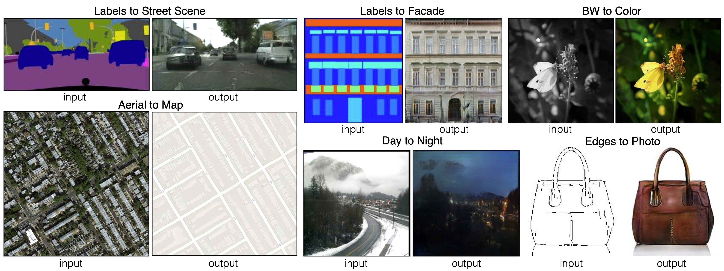
Pix2pixGan
https://arxiv.org/pdf/1611.07004.pdf

Slide 22
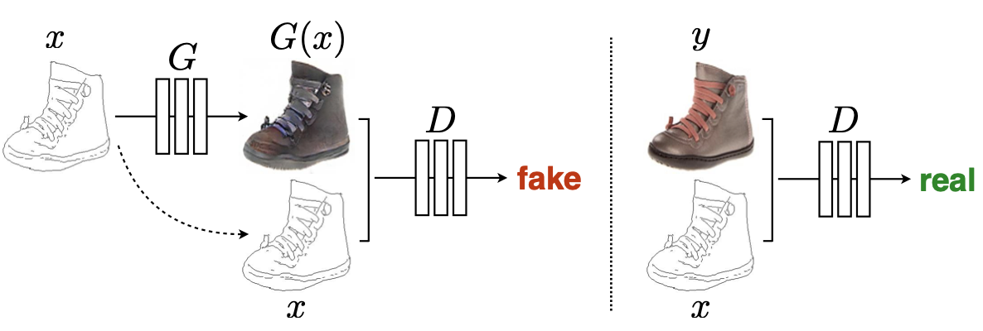
Pix2pixGan
https://arxiv.org/pdf/1611.07004.pdf

Slide 23
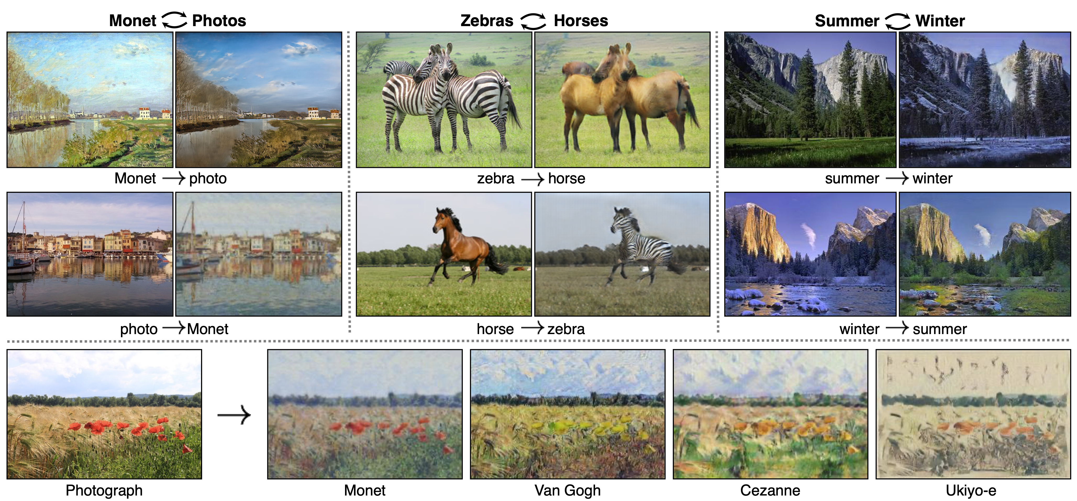
CycleGan
https://arxiv.org/pdf/1611.07004.pdf

Slide 24
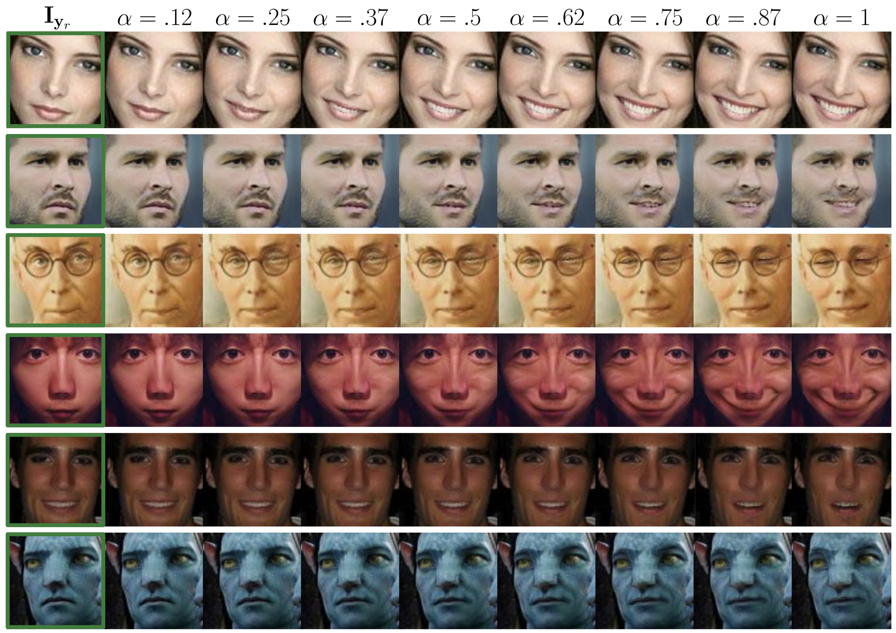
GANimation
https://arxiv.org/abs/1807.09251

Slide 25
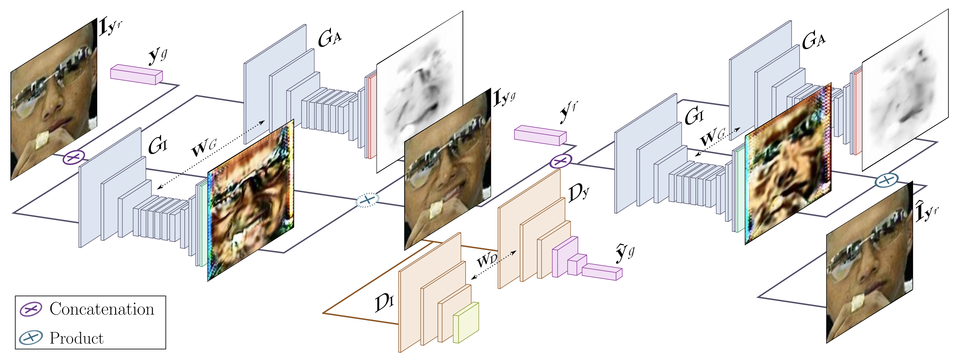
GANimation
https://arxiv.org/abs/1807.09251

Slide 26
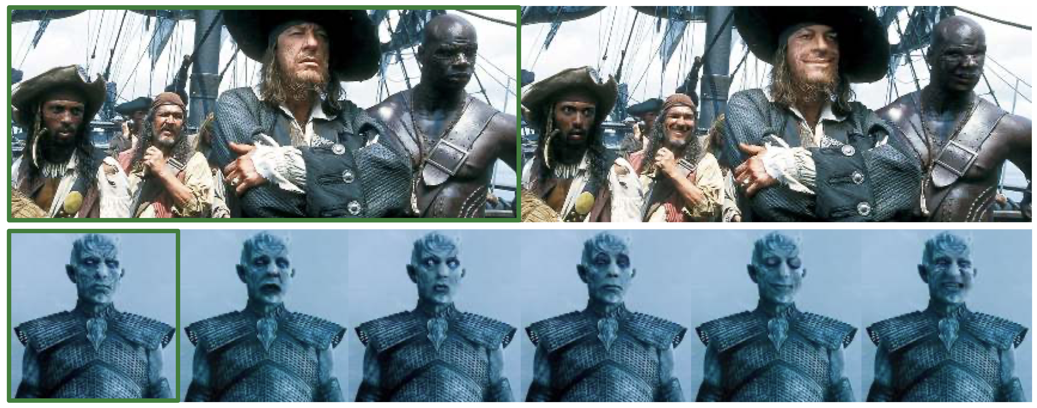
GANimation
https://arxiv.org/abs/1807.09251

Slide 27
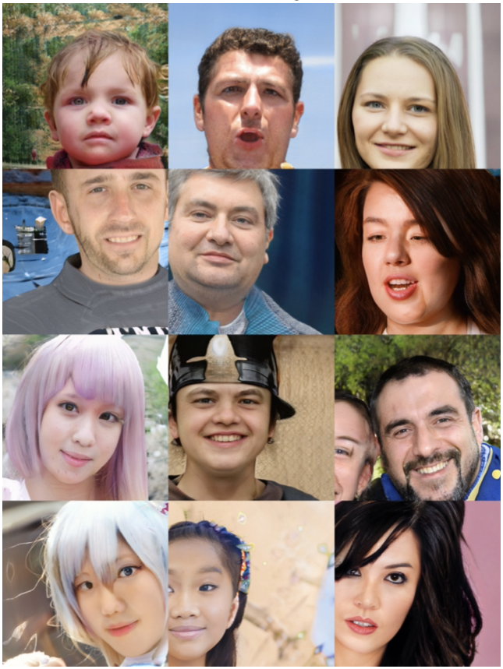
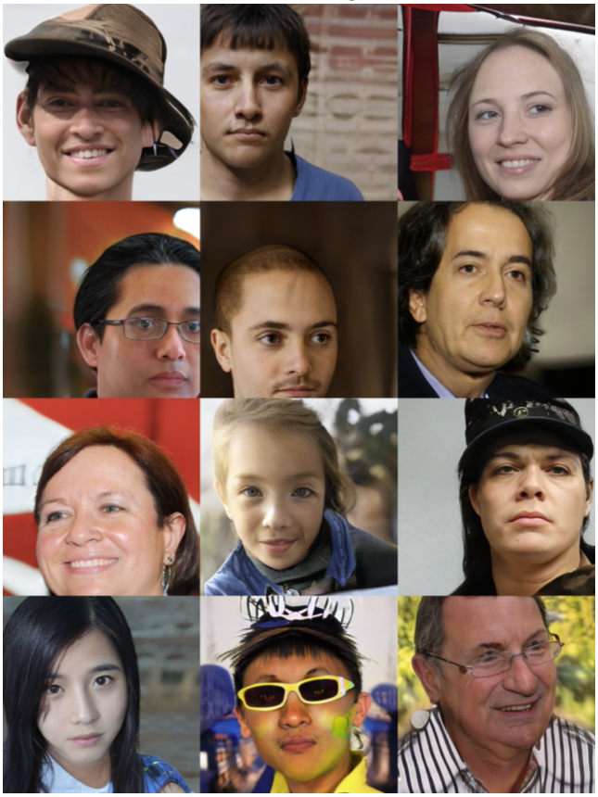
StyleGAN
https://arxiv.org/abs/1807.09251

Slide 28
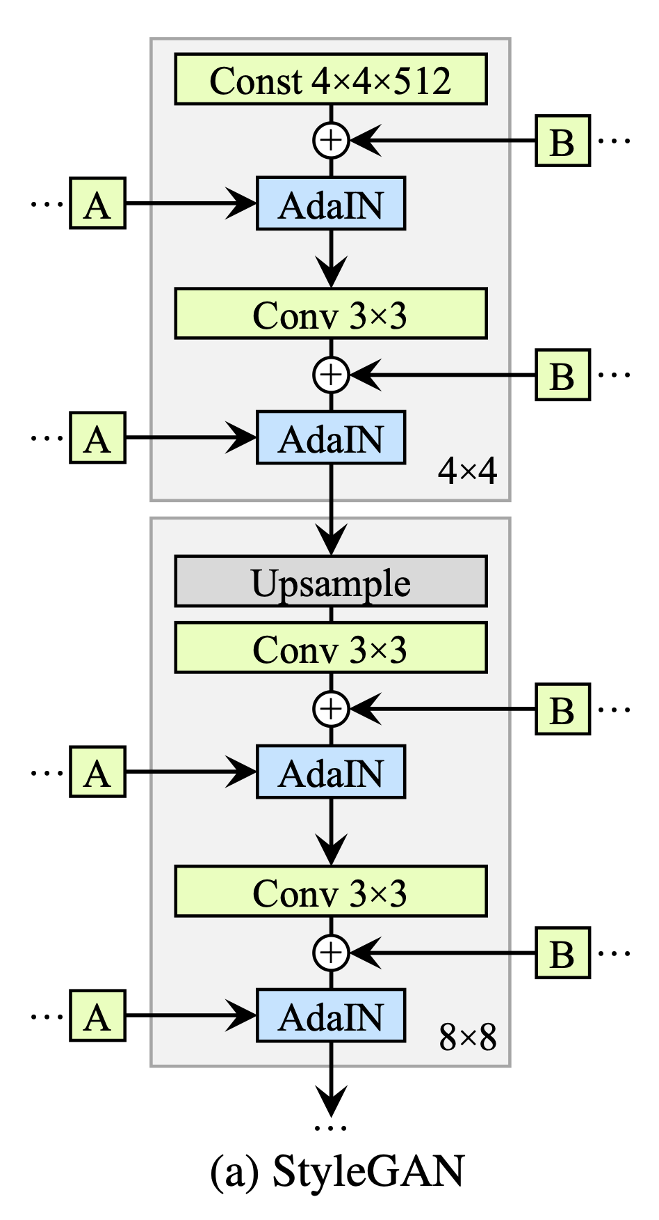
StyleGAN
https://arxiv.org/abs/1912.04958

Slide 29
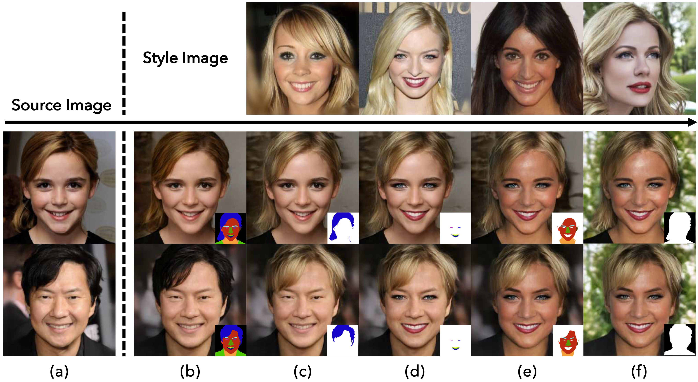
SEAN
https://openaccess.thecvf.com/content_CVPR_2020/papers/
Zhu_SEAN_Image_Synthesis_With_Semantic_Region-Adaptive_Normalization_CVPR_2020_paper.pdf

Slide 30
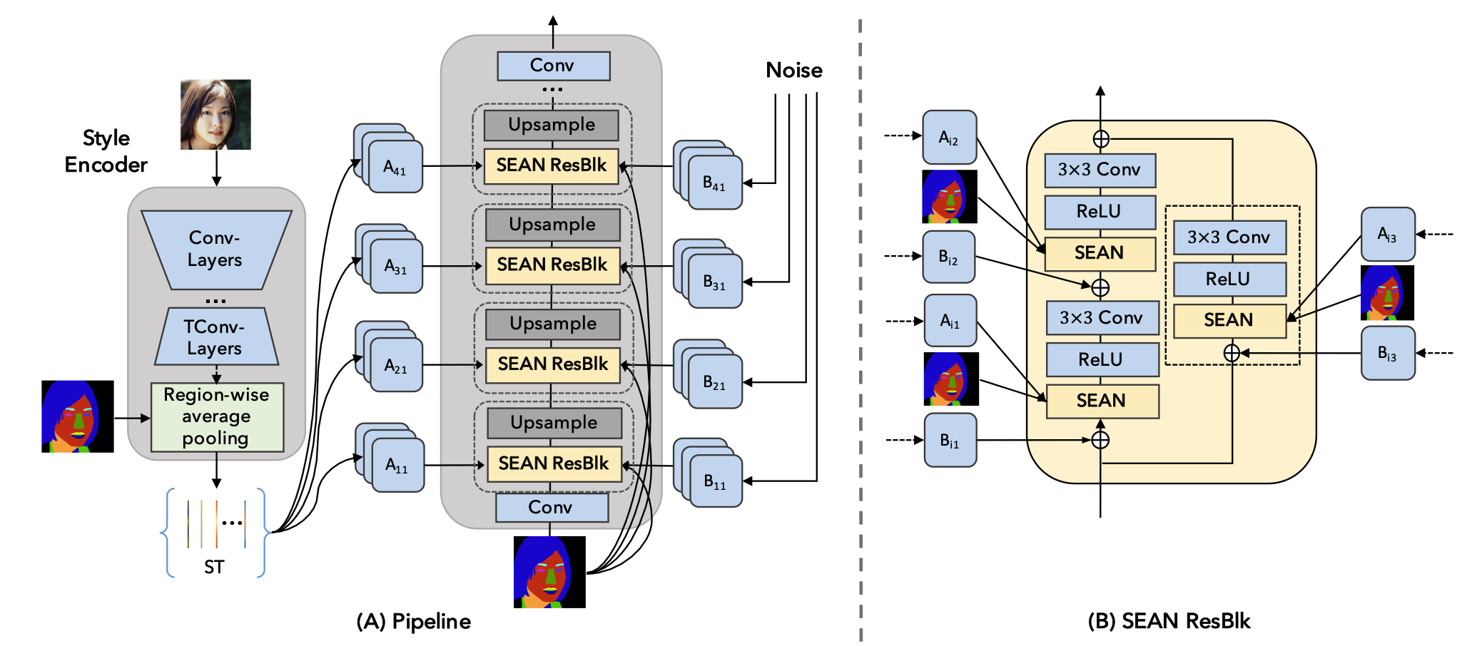
SEAN

Slide 31
Why We GAN?

Slide 32
Applications of GAN
Image Inpainting
Talking Face Synthesis
Pose Transfer
Super-Resolution
Fashion Editing
Style Transfer

Slide 33
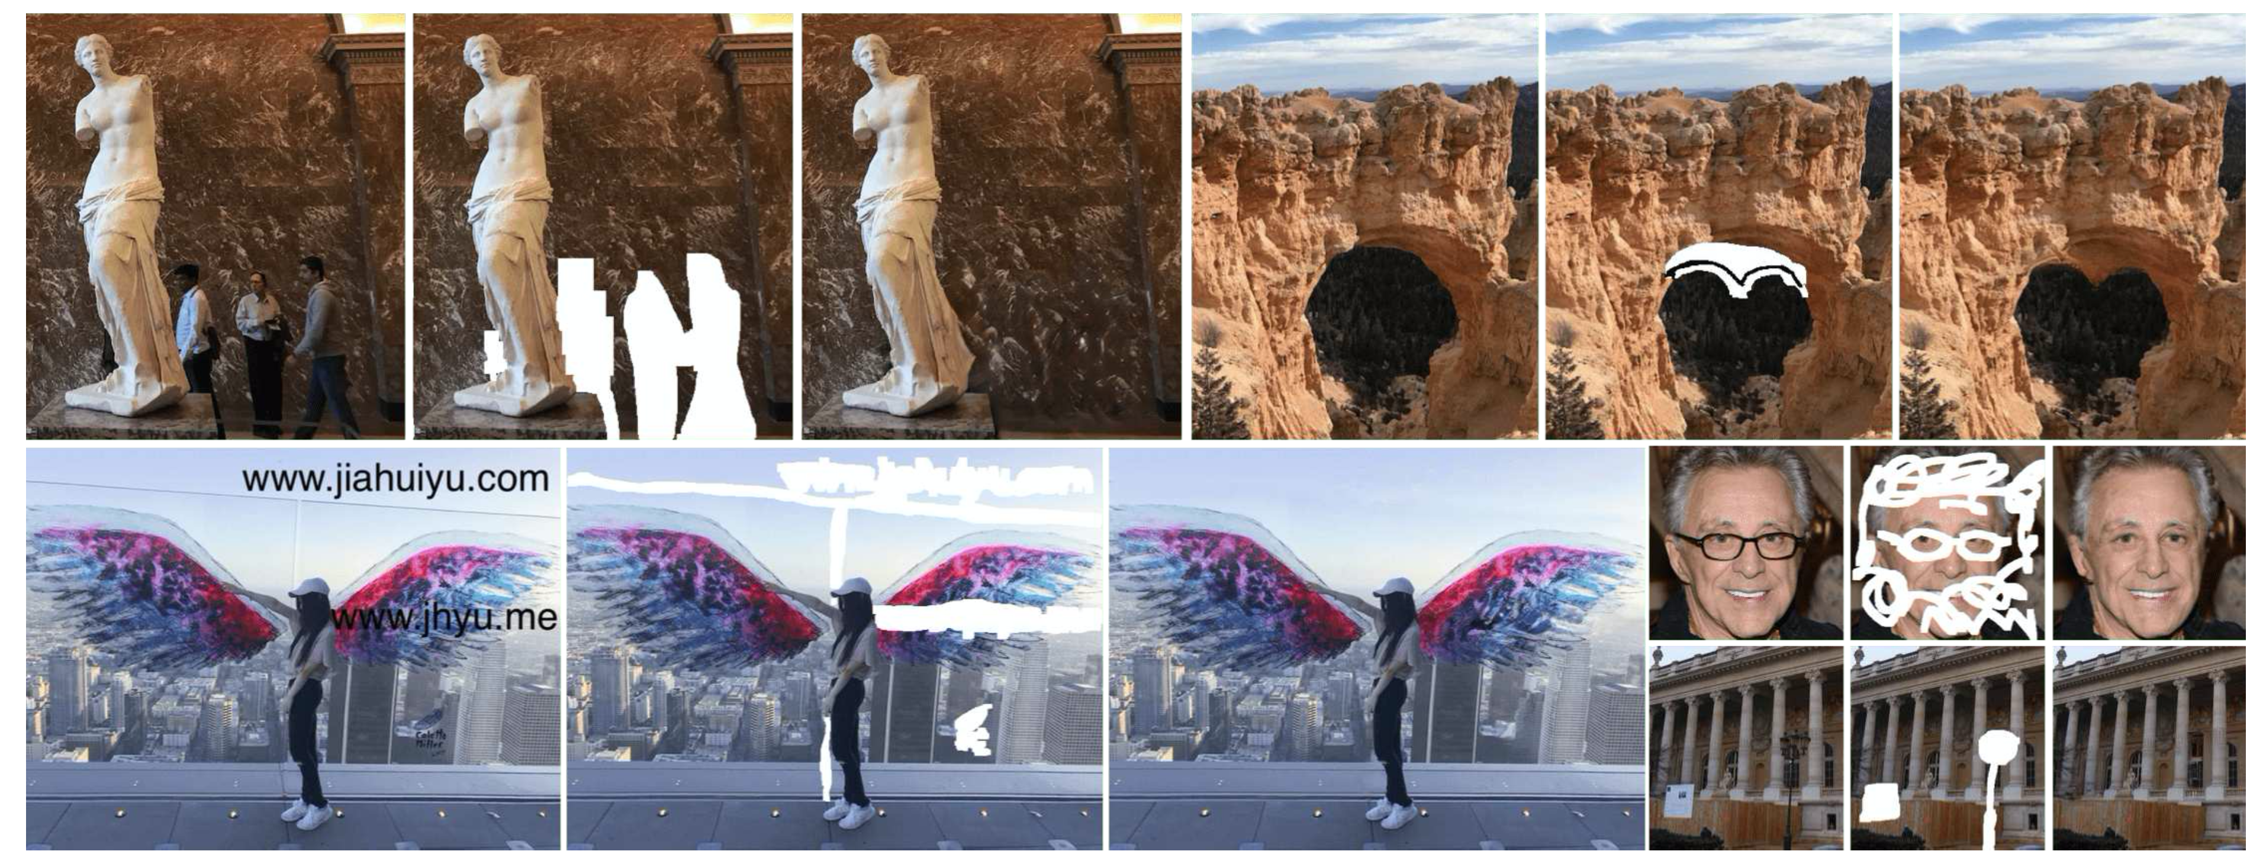
Image Inpainting (DeepFill V2)
https://arxiv.org/abs/1806.03589

Slide 34
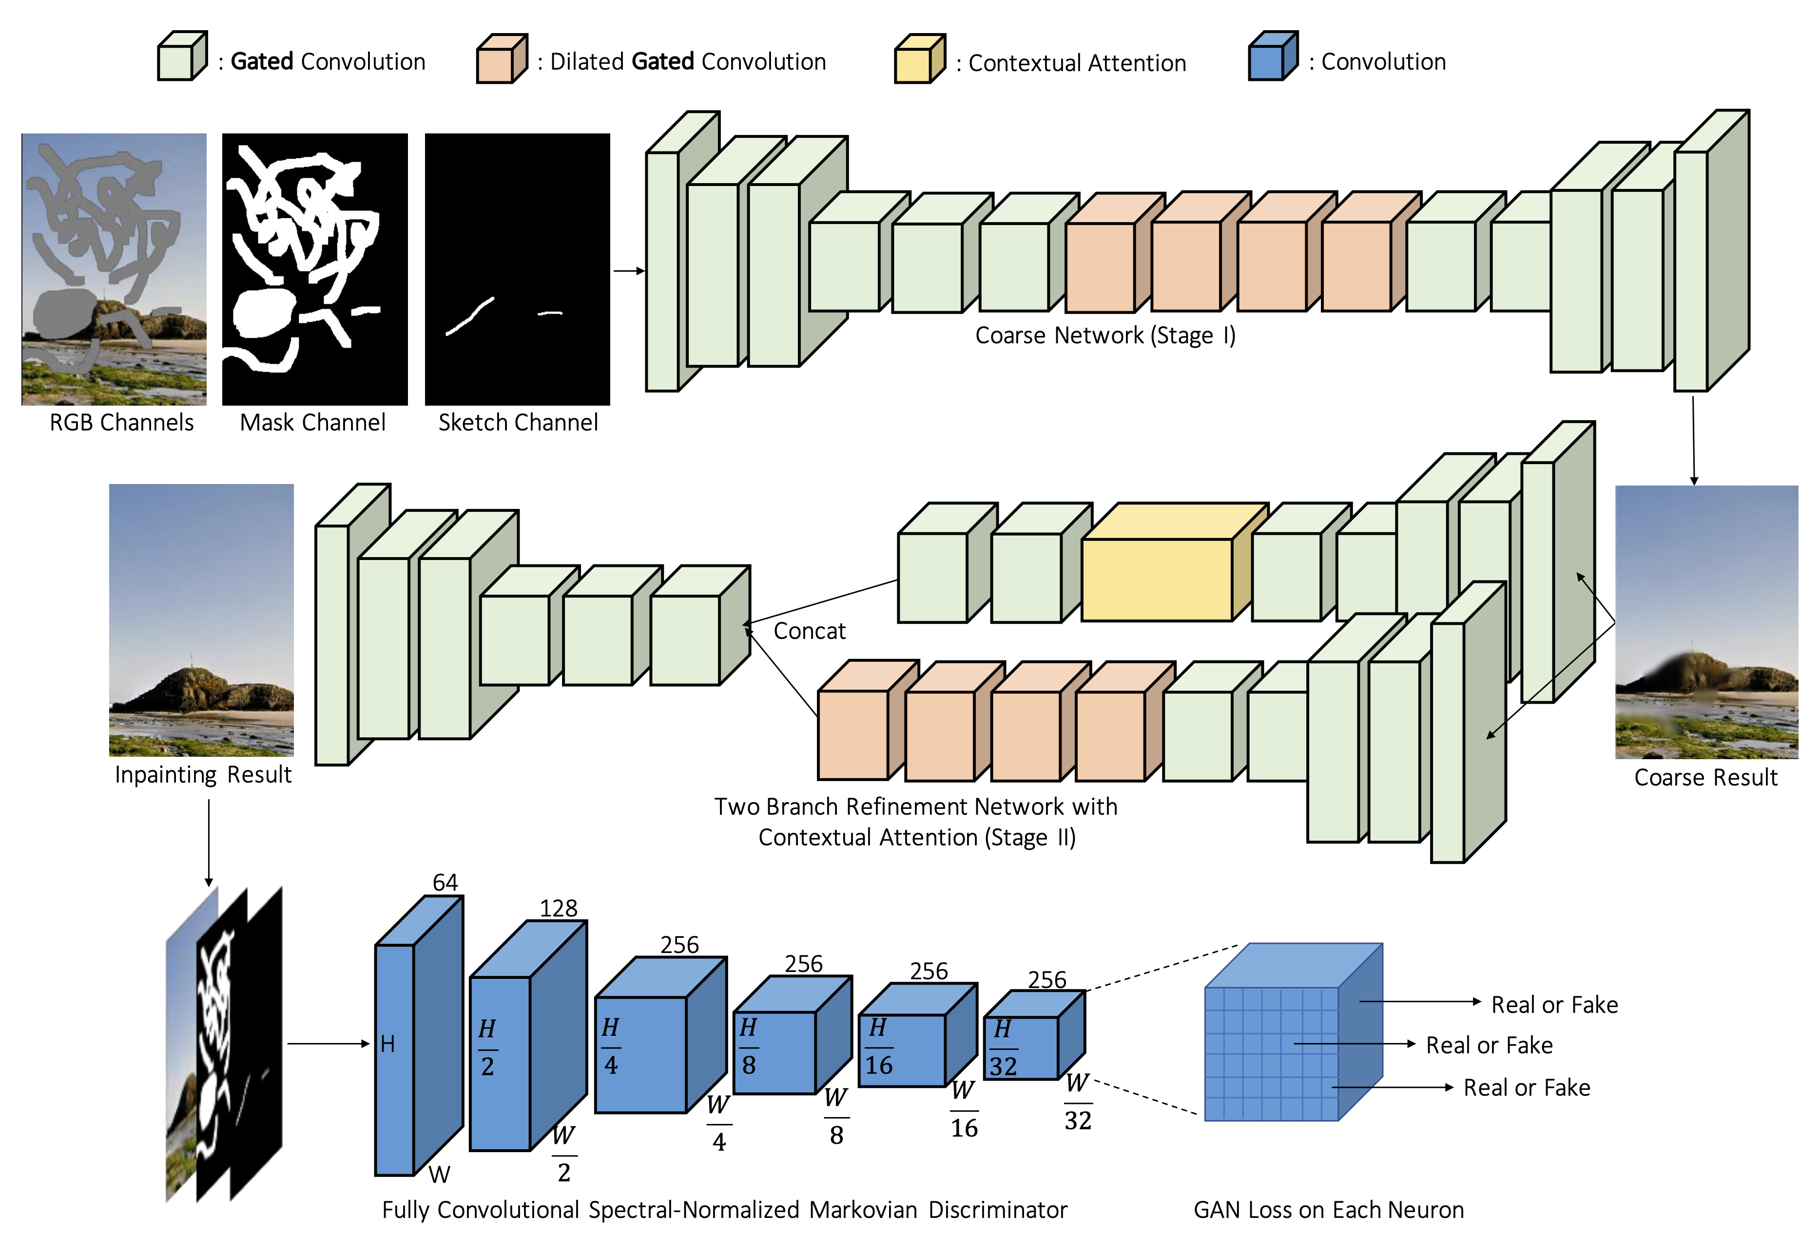
Image Inpainting (DeepFill V2)

Slide 35
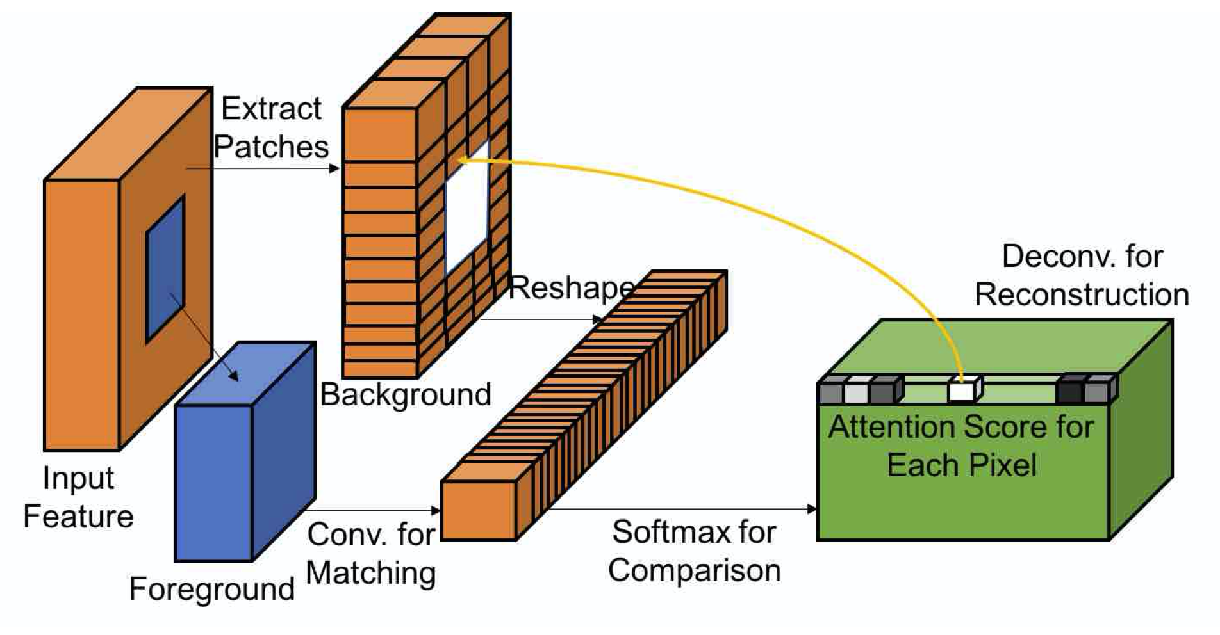
Image Inpainting (DeepFill V2)
https://arxiv.org/abs/1801.07892

Slide 36
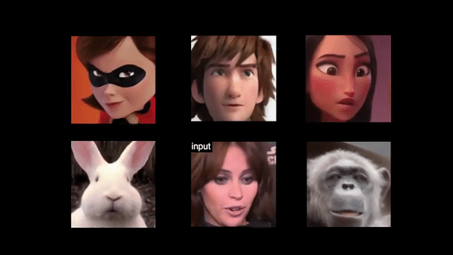
Talking Face Synthesis
https://github.com/Hangz-nju-cuhk/Talking-Face-Generation-DAVS

Slide 37
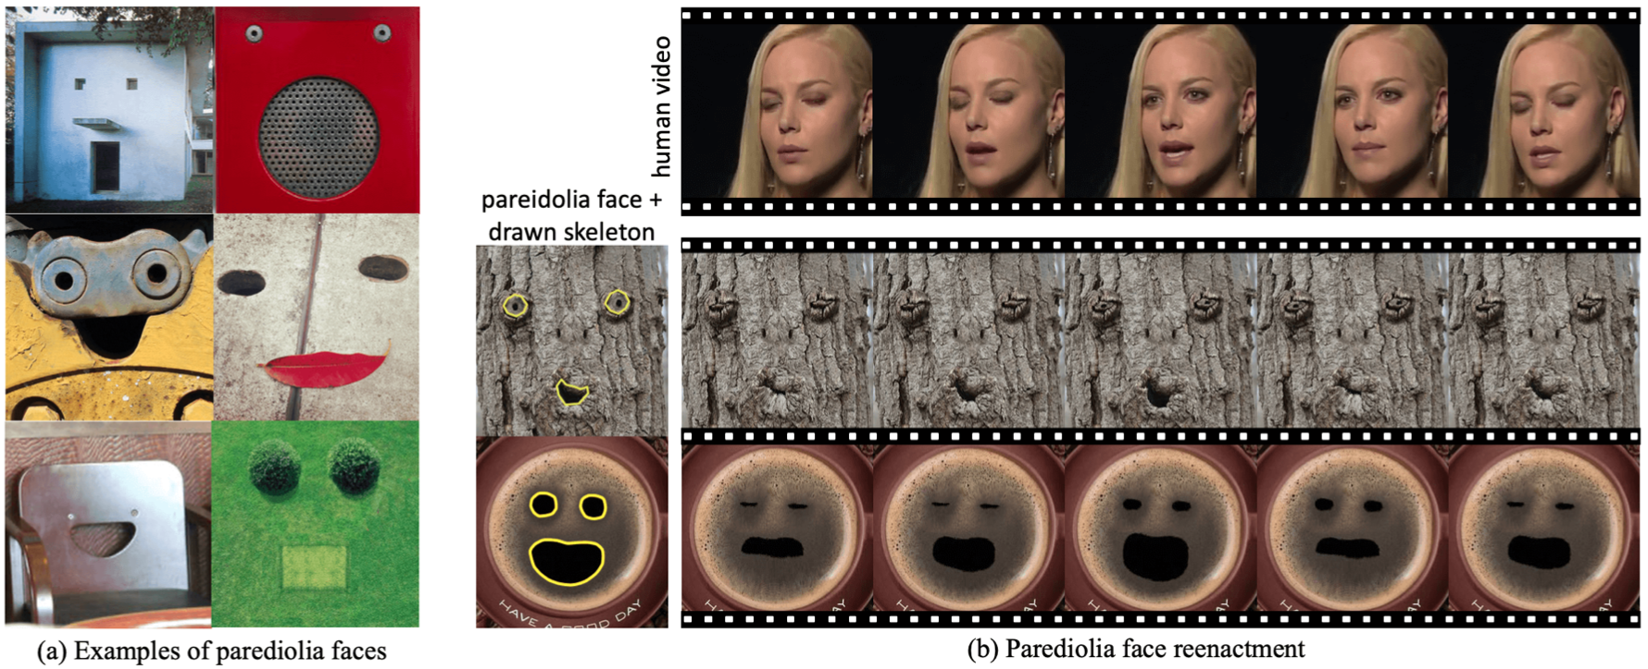
Talking Face Synthesis
Everything's Talkin': Pareidolia Face Reenactment

Slide 38
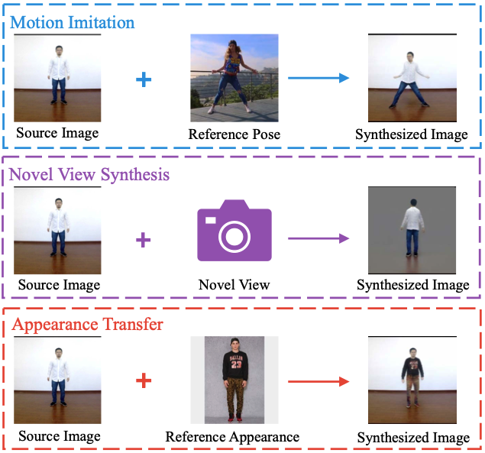
Pose Transfer (Liquid Warping GAN)
https://arxiv.org/abs/1909.12224

Slide 39
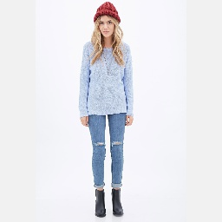
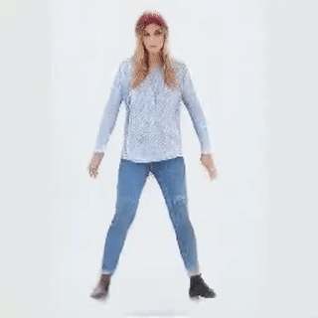
Pose Transfer (Liquid Warping GAN)
https://arxiv.org/abs/1909.12224

Slide 40
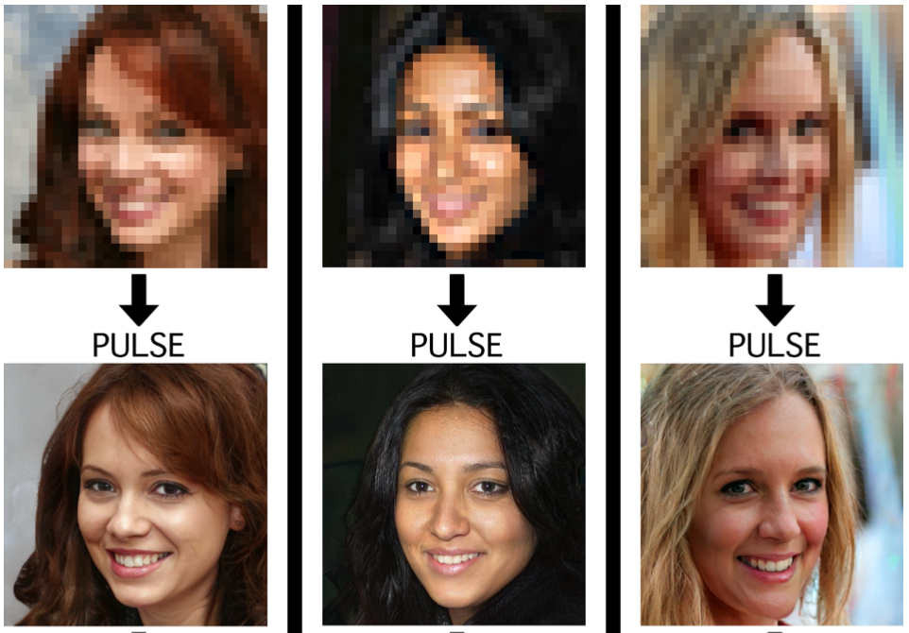
Super-Resolution
PULSE: Self-Supervised Photo Upsampling via Latent Space Exploration of Generative Models

Slide 41
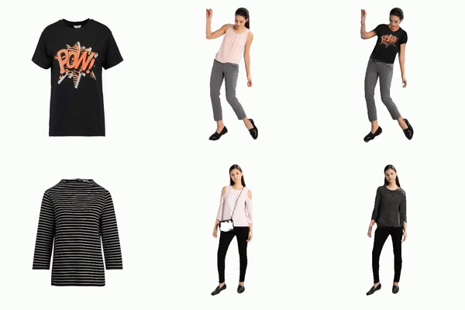
Fashion Editing
https://github.com/fyviezhao/m3d-vton

Slide 42
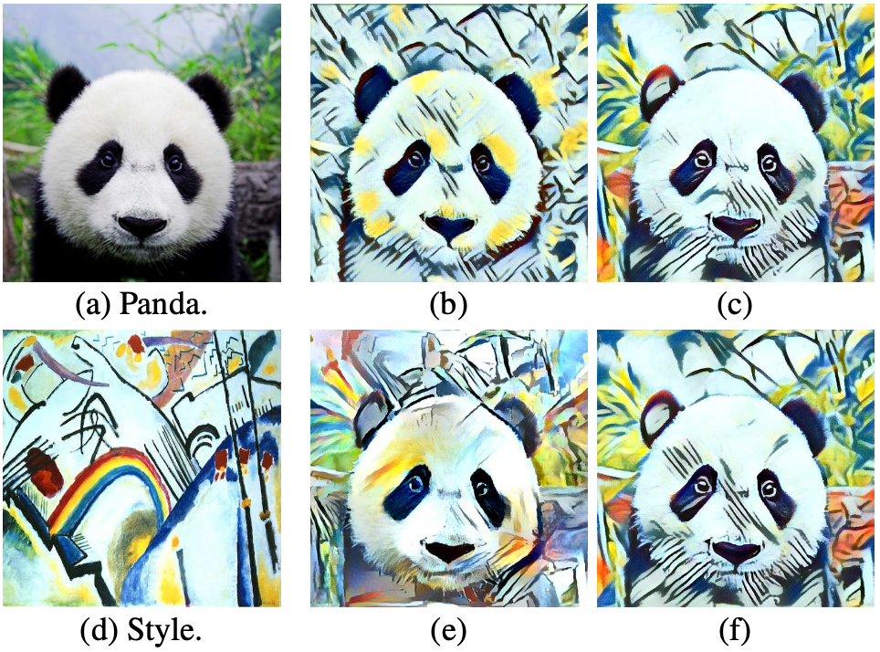
Style Transfer
Improved Texture Networks: Maximizing Quality and Diversity in Feed-forward Stylization and Texture Synthesis

Slide 43
Thanks

